Slide 1
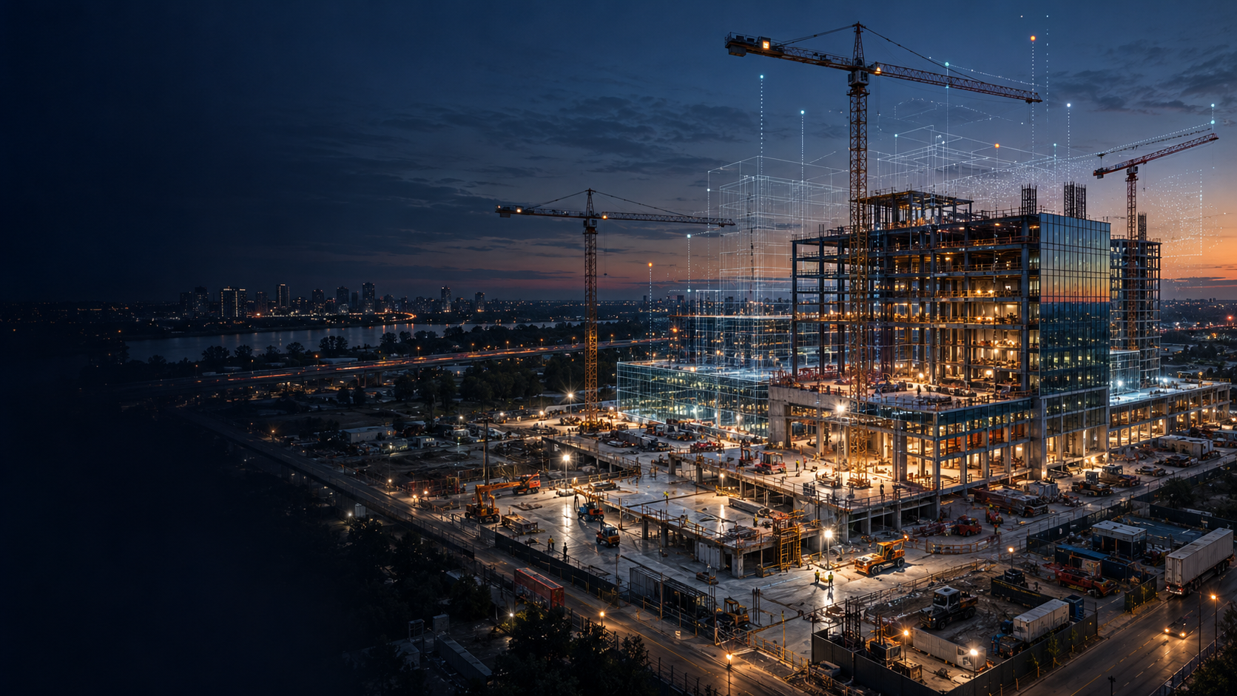
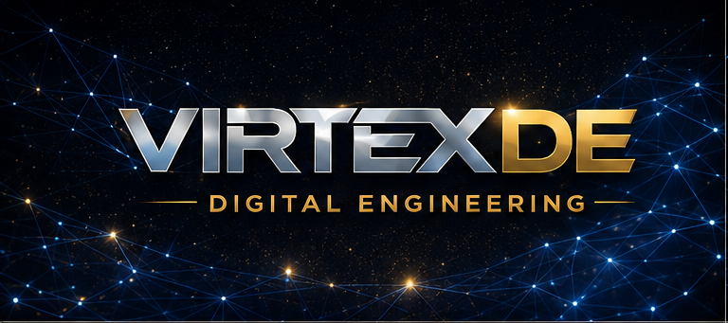
INVESTOR PRESENTATION
Construction intelligence built from real operations
Working draft | September 2026
Digital engineering, field intelligence and operational software under one brand.
VIRTEX DE | CONFIDENTIAL
01
Notes:
Cover image: AI-generated concept image created for this presentation, September 2026.
Virtex DE brand artwork supplied by the founder. Legal name and trademark clearance remain pending.

Slide 2
THE OPPORTUNITY
Investment thesis
Construction companies have bought the software. Many still lack the operating system that makes it useful.
01
02
03
04
Operator-led
Services wedge
Reusable data
Recurring platform
Virtex starts inside real project workflows, where adoption succeeds or fails.
Paid delivery creates customer access, cash flow and measurable outcomes.
Every engagement improves templates, benchmarks and decision logic.
Repeatable workflows become managed services and software modules.
The raise funds the transition from founder-led delivery to a repeatable construction intelligence company.
VIRTEX DE | CONFIDENTIAL
02
Notes:
Management thesis. No external factual claims on this slide.
The model deliberately treats services as the market-entry engine and recurring product revenue as the margin-expansion engine.

Slide 3
CUSTOMER PROBLEM
The implementation gap
Project information remains split across models, drawings, issues, schedules, cost systems and field capture.
1
Disconnected decisions
Teams reconcile the same facts manually across ACC, estimating, finance and field systems.
2
Deliverables without control
Traditional VDC vendors produce models and drawings. Project leaders still own the operating risk.
3
AI without trust
Weak data, unclear ownership and unverified outputs stop pilots from becoming daily workflows.
4
Talent bottlenecks
Few people understand construction operations, BIM, data integration and executive decision making together.
VIRTEX DE | CONFIDENTIAL
03
Notes:
Problem framing is based on the founder's construction operations experience and the supplied Digital Engineering SOP, strategy, checklist and SOW materials.
Source files reviewed: Digital Delivery SOP (rev. 9/1/24), Digital Engineering Strategy Form, Digital Engineering Kickoff Checklist, Plan + Control Checklist, vendor SOW templates.

Slide 4
MARKET SIGNALS
A large market is asking for practical AI
$2.158T
32%
68%
U.S. construction spending annual rate, July 2026
Construction leaders approaching or achieving AI goals
Trust in AI after real-world implementation challenges
17,850
2,710
Implementation
Procore organic customers at year-end 2025
Customers contributing more than $100,000 ARR
The near-term opening is outcome delivery, data readiness and workflow ownership.
External sources are listed in the speaker notes.
VIRTEX DE | CONFIDENTIAL
04
Notes:
U.S. Census Bureau, Monthly Construction Spending, July 2026. https://www.census.gov/construction/c30/current/index.html
Autodesk 2025 State of Design & Make: Spotlight on Construction. https://construction.autodesk.com/go/design-and-make-construction-spotlight-report/
Autodesk reports 32% of construction leaders are approaching or have achieved AI goals. The report page states trust in AI softened from 80% to 68% as firms encountered implementation challenges.
Procore FY2025 results. https://www.procore.com/press/procore-announces-fourth-quarter-and-full-year-2025-financial-results

Slide 5
SERVICES TO SOFTWARE
The Virtex business model
A paid delivery engine creates the evidence, data and customer access required to build recurring products.
01
02
03
04
CONSULT
DELIVER
PRODUCTIZE
SCALE
Diagnose workflow, risk and data gaps
Run VDC, drawing intelligence and field workflows
Convert repeated decisions into agents, connectors and benchmarks
Deploy proven modules across companies and portfolios
Fixed-fee assessment
Project fees
Managed subscription
Software revenue
Services prove value first. Product investment follows observed repetition and paid demand.
VIRTEX DE | CONFIDENTIAL
05
Notes:
Management strategy. Revenue forms and pricing are proposed and remain subject to customer discovery.

Slide 6

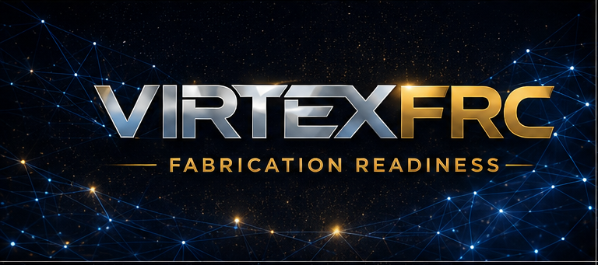
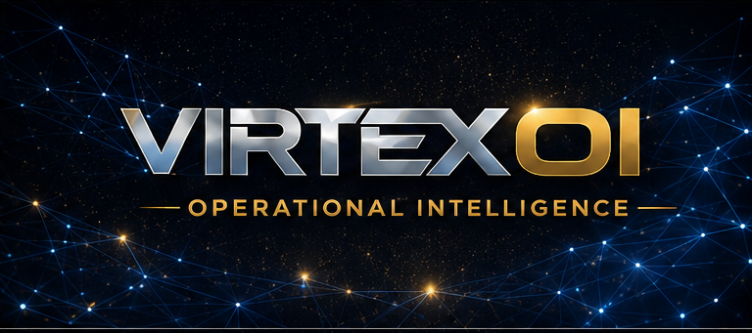


BRAND ARCHITECTURE
Virtex capability portfolio
Six specialized capabilities share one customer relationship, delivery system and data foundation.
BIM and VDC strategy, coordination and managed technology leadership.
Pursuit visuals, 4D sequencing and design communication.
Constructability, model health and fabrication handoff.
Connected data, drawing intelligence, agents and dashboards.
Layout, control and field verification tied to the model.
Drone, scanning, progress records and deviation analysis.
VIRTEX DE | CONFIDENTIAL
06
Notes:
Offer structure synthesized from the supplied Digital Engineering Department Overview, Visualization Services Menu, Digital Delivery SOP, Preconstruction SOP and founder-defined AtlasOI strategy.
Virtex must create original templates and software. The supplied Suffolk materials should not be copied into commercial deliverables without written permission.
Virtex brand artwork supplied by the founder on September 11, 2026.

Slide 7
EXECUTION CAPABILITY
A repeatable delivery system already exists
The founder has operated the full chain from pursuit strategy through field verification and turnover.
Pursuit
Preconstruction
Coordination
Field control
Turnover
Scope strategy
Budget
Client requirements
Phase planning
LOD and risk review
Design constraints
Model federation
Issue ownership
Sign-off
Layout
Reality capture
Deviation checks
As-builts
Asset data
Lessons learned
This operating knowledge becomes Virtex IP only after clean-room documentation, permission checks and independent implementation.
VIRTEX DE | CONFIDENTIAL
07
Notes:
Source basis: supplied Phase Plan Template, Plan + Control Checklist, Digital Engineering Kickoff Checklist, Digital Engineering Strategy Form, Digital Delivery SOP, Change Management SOP, peer review and project risk templates.
The slide describes founder experience and a proposed original Virtex system. It does not claim ownership of the supplied Suffolk files.

Slide 8
WHY THIS TEAM
Founder-market fit and early proof
Matthew Rodgers
Operating proof
Founder and proposed CEO
~$75M
01
Architect, BIM leader and VDC operator with experience inside large and regional contractors.
Founder-reported value of awarded work associated with programs supported since joining Harris. This is not Virtex revenue.
02
Current VP of Construction Technology with responsibility across digital delivery and operational intelligence.
Autodesk University speaker and former business owner with direct construction buyer access.
~50 users
03
Internal operational-intelligence prototype exposure, including a smaller power-user cohort.
04
Full-time CEO transition tied to financing and a written employment and IP carve-out.
1 identified anchor opportunity
VIRTEX DE | CONFIDENTIAL
08
Notes:
Founder background and operating metrics are based on prior user-provided information and require documentary support before external distribution.
The approximately $75M figure refers to work awarded at Harris after the founder joined. It is not revenue earned by Virtex and should not be presented as sole-cause attribution.
The internal platform experience is not represented as transferable Virtex IP.

Slide 9
CUSTOMER ACQUISITION
Anchor-led go to market
Start with companies that already trust the founder, then expand through the project ecosystem.
1
Anchor accounts
Regional GC and specialty contractor relationships. Multi-service annual agreement.
2
Project ecosystem
Owners, designers and trade partners reached through live projects and measurable outcomes.
3
Repeatable verticals
Data centers, hospitality, gaming, healthcare and complex commercial work.
4
Platform expansion
Deploy proven modules across portfolios after the workflow earns trust.
Initial sales motion
A 30-day diagnostic leads to a paid pilot, then an annual managed agreement and proven platform modules.
VIRTEX DE | CONFIDENTIAL
09
Notes:
Management plan. Named accounts should be added only after permission or a signed LOI.

Slide 10
WHERE VIRTEX FITS
Competitive position
High
VIRTEX DE
operator + platform
VDC
consultants
Target position
Execution depth
Staffing
vendors
Construction
software
Low
Low
Recurring platform value
High
Virtex competes first on implementation outcomes. Software margin expands only after the workflow proves repeatable.
VIRTEX DE | CONFIDENTIAL
10
Notes:
Illustrative competitive positioning by management. Categories are generalized and do not rank named competitors.

Slide 11
MANAGEMENT FORECAST
Illustrative three-year financial plan
$1.25M
Revenue in Year 1
50% blended gross margin
$3.38M
Revenue in Year 2
56% blended gross margin
$7.00M
Revenue in Year 3
62% blended gross margin
Year 3 EBITDA target
$1.16M
Forecast assumptions and mix are detailed in the speaker notes.
VIRTEX DE | CONFIDENTIAL
11
Notes:
Illustrative management forecast, not historical results.
Year 1 revenue: project services $0.80M, managed services $0.36M, platform $0.09M. Total $1.25M.
Year 2 revenue: project services $1.575M, managed services $1.20M, platform $0.60M. Total $3.375M.
Year 3 revenue: project services $2.50M, managed services $2.70M, platform $1.80M. Total $7.00M.
Gross margin assumptions by stream: Year 1 45% / 55% / 75%; Year 2 47% / 58% / 78%; Year 3 50% / 62% / 80%.
Operating expense assumptions: Year 1 $1.30M, Year 2 $2.00M, Year 3 $3.20M. Implied EBITDA: -$0.675M, -$0.096M, $1.164M.
Numbers require validation against signed backlog, staffing plan, founder compensation, insurance, tax and product-development scope.

Slide 12
CAPITAL PLAN
$1.25M seed raise
Allocation (%)
Proposed instrument
Post-money SAFE
$7.5M
Target valuation cap
16.7%
Approximate SAFE ownership at the cap before later dilution
Close structure
$500k initial close. $750k after two anchor customers or $500k signed backlog.
VIRTEX DE | CONFIDENTIAL
12
Notes:
Proposed terms for discussion only. Securities counsel must prepare and review financing documents.
YC Safe Financing Documents. https://www.ycombinator.com/documents
At a $7.5M post-money cap, $1.25M represents approximately 16.7% on the post-money SAFE capitalization basis, excluding later option-pool changes and priced-round dilution.
Use of funds: delivery team $500k; product and data $300k; sales and partnerships $200k; cloud and security $150k; legal, insurance and administration $100k.

Slide 13
WHAT THE CAPITAL BUYS
Eighteen-month milestones
0-90 DAYS
MONTH 6
MONTH 12
MONTH 18
Company ready
Market proof
Repeatability
Scale readiness
Entity and IP audit
Founder transition agreement
Two anchor LOIs
Three packaged offers
$750k signed backlog
Three paying accounts
Virtex delivery system v1
First recurring agreement
$1.5M annualized contracted revenue
30% recurring mix
Two paid intelligence modules
Documented implementation KPIs
$2.5M annualized revenue
40% recurring mix
Five paid platform customers
Seed extension or break-even path
Release the second tranche only after commercial proof. This protects both the founder and investors.
VIRTEX DE | CONFIDENTIAL
13
Notes:
Illustrative management milestones. Revenue and customer targets remain assumptions until validated by LOIs and signed contracts.

Slide 14
RECOMMENDED STRUCTURE
Independent company, optional Harris partnership
Issue | Recommended position | Purpose
Entity | Delaware C corporation, qualified in Nevada | Compatible with outside equity and conventional seed documents
Founder control | Founder starts with 85% before financing | Keeps decision authority with the operating founder
Team pool | 10% option and advisor pool | Supports key hires without giving passive partners large grants
Harris participation | Up to 5% earned or purchased plus an anchor-client agreement | Creates alignment without allowing indecision to block launch
Governance | Three seats: founder, investor, independent | Avoids a partner deadlock
IP and data | License or clean-room rebuild. Client data stays client-owned | Separates Virtex assets from employer and customer property
Counsel and a CPA should confirm entity, tax, employment, securities and IP treatment before circulation.
VIRTEX DE | CONFIDENTIAL
14
Notes:
Recommended structure for discussion, not legal or tax advice.
Delaware Division of Corporations advises consulting an attorney or CPA when choosing an entity. https://corp.delaware.gov/howtoform/
A Delaware company operating in Nevada may need foreign qualification and a Nevada business license. https://www.nvsos.gov/businesses/start-a-business/corporation
The founder percentage shown is before SAFE conversion. If a full $1.25M SAFE converts at a $7.5M post-money cap, the SAFE position is approximately 16.7% before later dilution.

Slide 15
DILIGENCE READINESS
The main risks are identifiable and manageable
Risk | Investor concern | Mitigation before close
Founder employment | Conflicts, time commitment and customer overlap | Written transition trigger, disclosure and non-solicit review
IP ownership | AtlasOI or employer materials may belong to Harris | IP audit, license where appropriate and clean-room Virtex code
Services concentration | Low margin and dependence on the founder | Packaged scope, delivery leads, offshore capacity and recurring managed contracts
Customer concentration | One anchor could control revenue | No customer exceeds 35% of revenue by month 18
Brand clearance | A similarly named UK company appears online | U.S. entity, domain and trademark search before launch
Professional liability | Models and AI outputs influence costly decisions | Human verification, contract limits, PL, cyber and GL coverage
Investor credibility improves when these issues appear in the plan before diligence begins.
VIRTEX DE | CONFIDENTIAL
15
Notes:
Risk assessment by management. Counsel, insurance broker and CPA review are required.
The founder supplied the Virtex brand family. The final legal name still requires formal U.S. and relevant international trademark searches.

Slide 16
INVESTOR FIT
The first money should come from strategic operators
Investor type | Why Virtex fits | Timing
Construction executives and owners | Fast diligence, customer access and direct understanding of the pain | Approach now
Regional family offices | Patient capital and strong Southwest real estate networks | Approach after two LOIs
Contech angels and operator syndicates | Relevant introductions and realistic expectations for services-led growth | Approach now
Brick & Mortar Ventures | AEC software and hardware investment focus | Best after paid product proof
Ironspring Ventures | Early-stage construction and industrial technology focus | Best after recurring revenue
Building Ventures and accelerators | Built-environment network and market validation | Use for network and later institutional round
Do not pitch Virtex as a general consulting firm. Lead with the repeatable workflow, proprietary data layer and recurring product path.
VIRTEX DE | CONFIDENTIAL
16
Notes:
These organizations are examples of fit, not indications of interest.
Brick & Mortar Ventures mission. https://brickmortar.vc/
Ironspring Ventures focus. https://ironspring.com/
Building Ventures investment thesis. https://buildingventures.com/building-ventures-investment-thesis/constructing-a-better-built-world/
Suffolk Technologies BOOST accelerator. https://suffolktech.com/boost/

Slide 17
THE ASK
$1.25M
Seed capital
Two anchor partners
Paid access to real workflows, referenceable outcomes and a path to recurring deployment.
Founder decision
Virtex will launch. The remaining decision is who joins the first round and helps shape the company.
VIRTEX DE | CONFIDENTIAL
17
Notes:
Closing position for investor discussions. Replace placeholder contact details and add a data-room link before external circulation.
Cover image: AI-generated concept image created for this presentation, September 2026.
Virtex DE brand artwork supplied by the founder on September 11, 2026.

